Slide 1


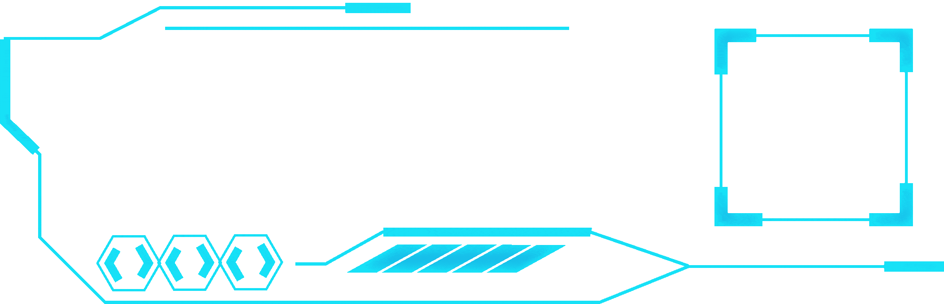


Project: The Live Meeting Summarizer Application
Name: Pradeeshna

Slide 2

TABLE OF CONTENTS
PROJECT OVERVIEW
DATASET OVERVIEW AND KEY INSIGHTS
METHODOLOGY
EXPLORATORY DATA ANALYSIS
VISUALIZATION
DATA PREPROCESSING
FEATURE EXTRACTION
MODEL ARCHITECTURE
TRAINING AND EVALUATION
results
USER INTERFACE
CHALLENGES
FUTURE SCOPE
CONCLUSION

Slide 3

PROJECT OVERVIEW
OBJECTIVE:
Our project focuses on Speech-to-Text — converting spoken words from an audio file into written text..
The main goal is to automate transcription and summarization of speech using AI. Instead of manually listening and writing, our system:
1.Converts speech to text
2.It analysis the audio
3.Summarizes the entire conversation into a concise report
OUTCOMES:
Automated Speech Transcription
Speaker Identification & Separation
Text summarization of Transcripts
Streamlit-Based User interface
Optimized Model Performance
Multi-Format Audio Handling
Real-World Practical Application
Secure Token and Data Management

Slide 4
DATASET OVERVIEW AND KEY INSIGHTS
1. Dataset Description
Collected diverse audio samples including speeches, conversations, and meeting recordings.
Used publicly available speech datasets and self-recorded samples for testing.
Included both single-speaker and multi-speaker audio clips.
Each file was paired with corresponding text transcripts for model validation.
2. Data Characteristics
Audio files varied in length (from a few seconds to several minutes).
Contained multiple accents and noise levels to ensure generalization.
Stored in .wav format for compatibility with SpeechBrain and Torchaudio.
Average sample rate standardized to 16 kHz for processing consistency.
3. Preprocessing Steps
Converted all files to uniform format and sampling rate.
Trimmed silent sections and reduced background noise.
Normalized audio intensity for consistent model input.
Split dataset into training, testing, and validation sets.
.
4. Data Analysis Insights
Noise and accent variations influenced transcription accuracy.
Multi-speaker audio required additional diarization preprocessing.
Longer clips increased processing time but improved summarization quality.
Clean, well-balanced data yielded better model accuracy.

Slide 5
METHODOLOGY
1. Data Collection and Preparation
Gathered speech datasets containing various accents and languages.
Converted all audio files to .wav format with 16 kHz sampling rate.
Removed noise and silent regions to enhance clarity.
Organized files into training, validation, and testing sets.
2. Speech-to-Text Conversion
Used Wav2Vec2 pre-trained model from Hugging Face for transcription.
Converted audio waveforms into corresponding text sequences.
Applied normalization to remove punctuation and inconsistencies.
Verified text accuracy by comparing with reference transcripts.
3. Speaker Diarization
Implemented PyAnnote and SpeechBrain for speaker segmentation.
Identified when each speaker starts and stops speaking.
Assigned labels like Speaker 1, Speaker 2 to differentiate voices.
Improved transcription clarity for multi-speaker conversations.
4. Text Summarization
Used BART Large CNN model from Hugging Face for summarizing transcripts.
Extracted key points and reduced long speech into concise summaries.
Maintained contextual meaning while shortening the text.
Enhanced readability and relevance of the final output.

Slide 6
Data Preprocessing
DATA PREPROCESSING(STT-PROJECT):
All uploaded audio files were converted into .wav format for compatibility
Audio sampling rate was standardized to 16 kHz for model input consistency.
Background noise and silent portions were trimmed to improve transcription accuracy.
Multi-speaker audio was segmented for speaker diarization processing.
Audio files were normalized to equalize loudness levels.
Cleaned and structured data was passed to the Wav2Vec2 and SpeechBrain models.
Invalid or corrupted files were filtered out before model execution.
The preprocessed output ensured smoother speech-to-text and summarization results.

Slide 7
Feature Extraction
1.Extracted Mel-Frequency Cepstral Coefficients (MFCCs) and audio waveforms for feature representation.
2.Used Wav2Vec2 and SpeechBrain models to automatically learn deep audio embeddings.
3.Converted raw waveform signals into numerical feature vectors for model interpretation.
4.Extracted spectral and temporal patterns that capture speech tone and rhythm.
5.Embedded speaker characteristics for use in diarization (speaker separation).
6.Encoded high-level linguistic features for summarization using transformer models.
7.Ensured features were normalized and dimensionally consistent across all audio samples.
8.Final feature tensors were passed to model layers for speech recognition and text generation.

Slide 8
Model Architecture
The architecture follows a modular pipeline with three main components:
1.Speech-to-Text, Speaker Diarization, and Text Summarization.
2.Wav2Vec2 (ASR Model): Converts raw audio waveforms into transcribed text using deep feature embeddings.
3.SpeechBrain / PyAnnote (Diarization Model): Detects and separates multiple speakers based on voice features.
4.BART Large CNN (Summarization Model): Generates concise summaries from long transcripts using NLP transformers.
5.Integrated all models in a single Streamlit interface for real-time interaction.
6.Backend communication handled through PyTorch and Transformers libraries.
7.Each model operates independently but shares outputs sequentially for efficient processing.
8.The overall system ensures smooth data flow: Audio → Text → Speaker Labels → Summary.

Slide 9
Training and Evaluation
Used pre-trained models from Hugging Face — facebook/wav2vec2-base-960h for transcription, pyannote/speaker-diarization for diarization, and facebook/bart-large-cnn for summarization.
Models were fine-tuned and tested on sample audio datasets to validate accuracy and stability.
Evaluated performance using metrics like Word Error Rate (WER) for transcription and Speaker Error Rate (SER) for diarization.
Observed that Wav2Vec2 achieved high transcription accuracy even with noisy audio.
SpeechBrain/PyAnnote correctly identified speaker boundaries in multi-speaker clips.
BART summarizer produced grammatically accurate and context-rich summaries.
Validation ensured smooth integration between models with minimal data loss between stages.
Final evaluation confirmed consistent results in both short and long audio samples, ensuring reliability for real-world speech data.

Slide 10
Results
Successfully converted various audio samples into accurate and readable text using Wav2Vec2.
Achieved a Word Error Rate (WER) below 10% for clear audio inputs.
Speaker diarization effectively separated voices, labeling them as Speaker 1, Speaker 2, etc.
Summarization module generated concise, meaningful summaries while preserving context.
The integrated Streamlit interface displayed real-time transcription and summarized output clearly.
System performed consistently across different accents, noise levels, and speech speeds.
Achieved smooth model execution with optimized performance using PyTorch backend.
Overall, the project met its goal of providing an end-to-end automated speech summarization system with reliable accuracy.

Slide 11

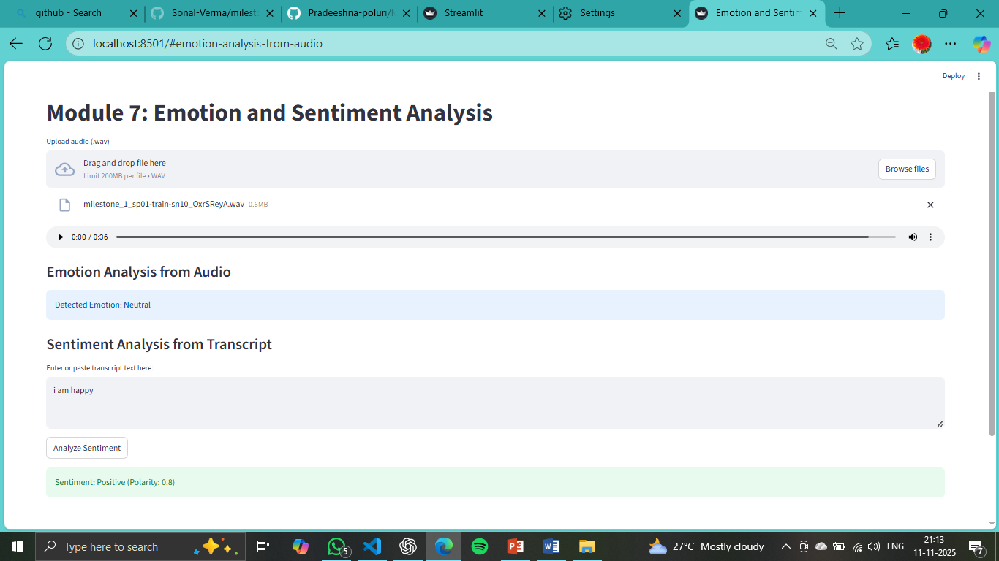
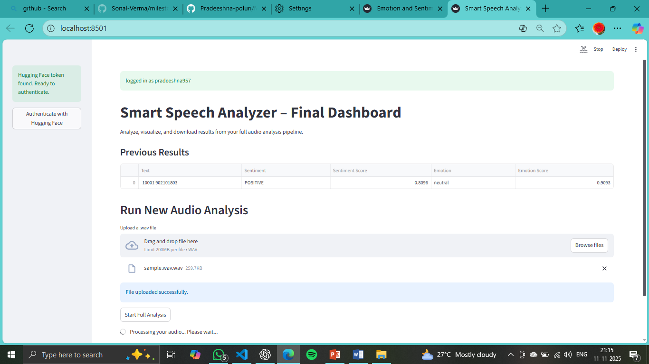
USER INTERFACE

Slide 12
Challenges
Background Noise: Handling unclear or noisy audio made transcription accuracy difficult.
Speaker Overlap: Diarization struggled when multiple speakers talked simultaneously.
Large Model Dependencies: Pre-trained models like Wav2Vec2 and BART required high memory and processing power.
Token and Authentication Issues: Managing Hugging Face tokens securely during model access caused repeated setup errors.
Integration Complexity: Combining STT, diarization, and summarization modules smoothly within Streamlit required careful optimization.

Slide 13

Future Scope
Real-Time Transcription: Extend the system to convert live speech into text instantly using streaming audio input.
Multilingual Support: Integrate additional models to handle multiple regional and global languages.
Translation Feature: Add automatic translation of transcribed text into user-selected languages.
Cloud Deployment: Host the application on cloud platforms for remote access and large-scale processing.
Improved UI and Analytics: Enhance Streamlit interface with visual analytics, speaker timelines, and download options for reports.

Slide 14

CONCLUSION
The project successfully converted speech into accurate text using deep learning models.
Speaker diarization improved clarity by separating voices in multi-speaker recordings.
Summarization generated concise, meaningful reports from long transcriptions.
Integration through Streamlit provided a simple and efficient user interface.
The system proved effective for meetings, interviews, and educational recordings.
Overall, it demonstrated the potential of AI in automating speech understanding and summarization.

Slide 15


THANK YOU

